Slide 1
The Ten Most Misunderstood Words in the Bible

Slide 2
The Ten Most Misunderstood Words in the Bible

Slide 3
Have You Ever Been Lost?

Slide 4
Have You Ever Been Lost?

Slide 5
Have You Ever Lost Something?

Slide 6
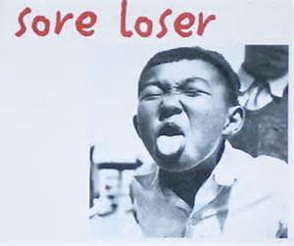
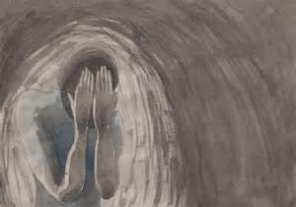
Losing is Bad?

Slide 7
Losing is Good?

Slide 8
Lose to Gain
“…whoever loses his life for My sake will find it.”
Matthew 16:25

Slide 9
Lose to Gain

Slide 10
Lose to Gain

Slide 11
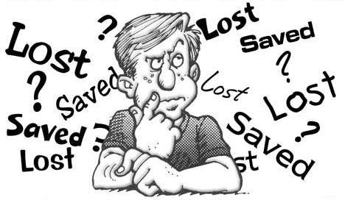
Lost Salvation?

Slide 12
What is Lost?
New King James Version
“lost” - “apoloolós” “apollumi”
“lose”; “loss”; “perish”; “destroy”
NT – 92x’s
“to destroy fully”;
“death”, “ruin” or “punishment”

Slide 13
What is Lost?
Conventional Definition of
“Lost”

Slide 14
What is Lost?
“For God so loved the world that He gave His only begotten Son, that whoever believes in Him should not perish but have everlasting life.” (John 3:16)

Slide 15
What is Lost?
Exegetical Transfer
It is a mistake in interpretation, to assume that the meaning of a word in one context is the meaning, or a primary meaning it has throughout the entire Bible.

Slide 16
What is Lost?
Exegetical Transfer
The meaning of “perish” in John 3:16 is eternal condemnation. It is the loss of life eternally.
Is that what it means in every context? No!

Slide 17
What is Lost?
Physical Death
“Arise, take the young Child and His mother, flee to Egypt, and stay there until I bring you word; for Herod will seek the young Child to destroy Him.” (Mt. 2:13)

Slide 18
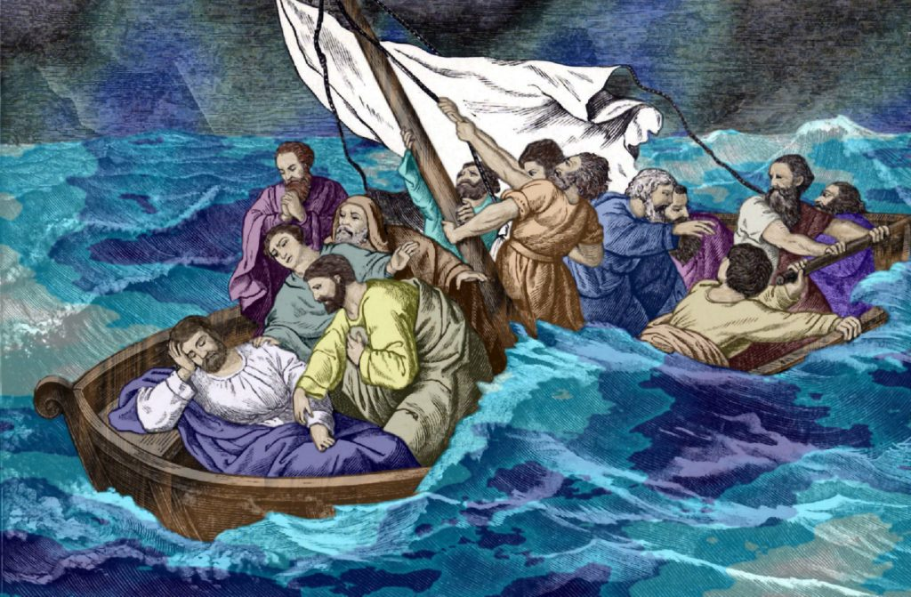
What is Lost?
Physical Death
“LORD save us! We are perishing” (Mt. 8:25)

Slide 19
What is Lost?
“Nor let us commit sexual immorality, as some of them did, and in one day twenty-three thousand fell; nor let us tempt Christ, as some of them also tempted, and were destroyed by serpents.” (1 Cor. 10:8-9)

Slide 20
What is Lost?
Physical Death
“…the Lord, having saved the people out of the land of Egypt, afterward destroyed those who did not believe.” (Jude 5)

Slide 21
What is Lost?
Physical Death
“Woe to them! For they have gone in the way of Cain, have run greedily in the error of Balaam for profit, and perished in the rebellion of Korah.” (Jude 11)

Slide 22
What is Lost?
Physical Death
Caiaphas said, “…do you consider that it is expedient for us that one man should die for the people, and not that the whole nation should perish.” (Jn. 11:50)

Slide 23
What is Lost?
Physical Death
Speaking of the blood of the prophets, Jesus said, “…from the blood of Abel to the blood of Zechariah who perished between the altar and the temple.” (Lk. 11:51)

Slide 24
What is Lost?
“Do you suppose that these Galileans were worse sinners than all other Galileans, because they suffered such things? I tell you, no; but unless you repent you will all likewise perish…” (Lk. 13:3,5)

Slide 25
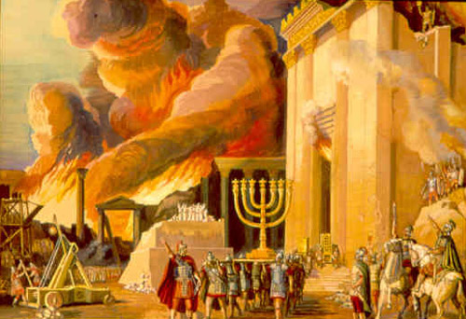
What is Lost?
Many of them did fail to repent and one million perished in the Jewish War in AD 66-70.

Slide 26
What is Lost?
“And as it was in the days of Noah, … They ate, they drank, they married wives, they were given in marriage, until the day that Noah entered the ark, and the flood came and destroyed them all.” (Lk. 17:26-27)

Slide 27
What is Lost?
Physical Death
“…on the day that Lot went out of Sodom it rained fire and brimstone from heaven and destroyed them all.” (Lk. 17:29)

Slide 28
What is Lost?
Physical Death
“For this they willfully forget: that by the word of God… by which the world that then existed perished, being flooded with water.” (2 Pt. 3:5-6)

Slide 29
What is Lost?
Physical Death
“…Therefore what will the owner of the vineyard do to them? He will come and destroy those vinedressers and give the vineyard to others.” (Lk. 20:9-16)

Slide 30
What is Lost?
“The Lord is not slack concerning His promise, as some count slackness, but is longsuffering toward us, not willing that any should perish but that all should come to repentance.” (2 Peter 3:9)

Slide 31
What is Lost?
Common: God doesn’t want anyone to be eternally condemned, but desires all to be saved…
Context: The Day of the LORD is coming in which billions of people who die physically…

Slide 32
What is Lost?
“God wishes that none should die prematurely under His hand of temporary wrath (during the Tribulation), but that all should come to repentance and extend their lives and their experience of His blessings” [Wilkin, p. 67]

Slide 33
What is Lost?
Physical Death
32 of the 92 uses of “apollumi” refer to physical death, making it the single most common meaning of the word.

Slide 34
What is Lost?
Temporary Loss or Ruin
The second most common meaning 21 of the 92 uses of “apollumi” refer to temporary loss, destruction, ruin.

Slide 35
What is Lost?
Temporary Loss or Ruin
“So when they were filled, He said to His disciples, ‘Gather up the fragments that remain, so that nothing is lost.” (Jn. 6:12)

Slide 36
What is Lost?
Temporary Loss or Ruin
“Nor do they put new wine into old wineskins, or else the wineskins break, the wine is spilled, and the wineskins are ruined.” (Mt. 9:17)

Slide 37
What is Lost?
“You will be betrayed even by parents and brothers, relatives and friends; and they will put some of you to death. And you will be hated by all for My name's sake. But not a hair of your head shall be lost.” (Lk. 21:18)

Slide 38
What is Lost?
Temporary Loss or Ruin
The Lord promises His disciples that even if they are betrayed and hated, even suffering death, ultimately their loss will be restored and rewarded.

Slide 39
What is Lost?
“Yet if your brother is grieved because of your food, you are no longer walking in love. Do not destroy [hurt, damage] with your food the one for whom Christ died.” (Rom. 14:15)

Slide 40
What is Lost?
Temporary Loss or Ruin
“And if Christ is not risen, your faith is futile; you are still in your sins! Then also those who have fallen asleep [died] in Christ have perished.” (1 Cor. 15:18)

Slide 41
What is Lost?
Some might say this could refer to eternal perishing [condemnation], but more likely it refers to the loss of physical existence. If Christ is not raised physically then those in Christ will not be physically raised either.

Slide 42
What is Lost?
“With no physical resurrection believers who have died have permanently lost their bodies, never to regain them again” [Wilkin, p. 60]

Slide 43
What is Lost?
“…the genuineness of your faith, being much more precious than gold that perishes, though it is tested by fire, may be found to praise, honor, and glory at the revelation of Jesus Christ,” (1 Peter 1:7)

Slide 44
What is Lost?
“Look to yourselves, that we do not lose those things we worked for, but that we may receive a full reward.” (2 John 8)
This refers to the loss of reward at the Judgment Seat of Christ.

Slide 45
What is Lost?
The Loss of Life
“For whoever desires to save his life will lose it, but whoever loses his life for My sake will find it.” (Mt. 16:25)

Slide 46
What is Lost?
The Loss of Life
This is NOT referring to heaven or hell!
This concerns disciples, “If anyone desires to come after Me, let him deny himself, and take up his cross, and follow Me.” (16:24)

Slide 47
What is Lost?
The Loss of Life
“For whoever desires to have the good life now will lose it, but whoever postpones the good life for My sake will gain/profit the good life later” (16:25)

Slide 48
What is Lost?
The Loss of Life
“For what profit is it to a man if he gains the whole world, and loses his own soul/life? Or what will a man give in exchange for his soul/life, the fullness of life?” (16:26)

Slide 49
What is Lost?

Slide 50
What is Lost?
The Loss of Life
“For the Son of Man will come in the glory of His Father with His angels, and then He will reward/profit each according to his works.” (Mt. 16:27)

Slide 51
What is Lost?
The Loss of the Fullness of Life
Jesus is telling His disciples that in order to save their fullness of life their treasure and reward forever, they must deny themselves…; this means they lose their lives in some sense here and now.

Slide 52
What is Lost?
The Loss of the Fullness of Life
“whoever gives one of these little ones only a cup of cold water in the name of a disciple, assuredly, I say to you, he shall by no means lose his reward.” (Mt. 10:39, 42)

Slide 53
What is Lost?
The Loss of the Fullness of Life
The same teaching is given here where the issue is primarily the fullness or the lack of fullness of life in the life to come.

Slide 54
What is Lost?
The Loss of the Fullness of Life
“If we cling to our goods and possessions, that is if we lay up treasures on earth, then we will forfeit treasures in heaven.” [Wilkin, p. 63]

Slide 55
What is Lost?
The Loss of the Fullness of Life
We cannot lose our eternal life [its length or quantity], but we can lose the fullness of eternal life [its depth, or quality] .

Slide 56
What is Lost?
The Gain of the Fullness of Life
We cannot gain eternal life [its length or quantity], it is a gift of God, but we can gain the fullness of eternal life [its depth, or quality], it is a reward according to our work.

Slide 57
Who is Lost?
Who are the lost people?
Unbeliever or Unregenerate?
Can believers be considered lost?

Slide 58
Who is Lost?
The Lost Sheep, Coin, Son
In Luke 15 we find the parable of the lost sheep, the lost coin, and the lost son.

Slide 59
Who is Lost?
The Lost Sheep
“What man of you, having a hundred sheep, if he loses one of them, does not leave the ninety-nine in the wilderness, and go after the one which is lost until he finds it?” (Luke 15:4)

Slide 60
Who is Lost?
The Lost Sheep
“And when he comes home, he calls together his friends and neighbors, saying to them, ‘Rejoice with me, for I have found my sheep which was lost!” (Luke 15:6)

Slide 61
Who is Lost?
The Lost Coin
“Or what woman, having ten silver coins, if she loses one coin, does not light a lamp, sweep the house, and search carefully until she finds it?”(Luke 15:8)

Slide 62
Who is Lost?
The Lost Coin
“And when she has found it, she calls her friends and neighbors together, saying, ‘Rejoice with me, for I have found the piece which I lost!”(Luke 15:9)

Slide 63
Who is Lost?
The Lost Son
“…this my son was dead and is alive again; he was lost and is found.’ And they began to be merry.” (Luke 15:24)

Slide 64
Who is Lost?
The Lost Son
“It was right that we should make merry and be glad, for your brother was dead and is alive again, and was lost and is found.” (Luke 15:32)

Slide 65
Who is Lost?
The Lost Sheep, Coin, Son
Notice: Every case, the sheep, the coin, and the son are the present possession of their owner -- “my sheep”, “my coin” and “my son”.

Slide 66
Who is Lost?
The Lost Sheep, Coin, Son
The parable concerns believers who leave the fold and become lost in the world, and then return and are found again by the Lord. We should all rejoice in their return / repentance.

Slide 67
Who is Lost?
The Lost Sheep, Coin, Son
To be in out of fellowship is to be lost and dead.
To be in fellowship is to be alive and found.

Slide 68
Saving the Lost
“For the Son of Man has come to save that which was lost.”* (Mt. 18:11)
“…for the Son of Man has come to seek and to save that which was lost.” (Luke 19:10)

Slide 69
Saving the Lost
The readers would have thought back to the three parables of the Luke 15 about the God seeking the lost believers.
“…for the Son of Man has come to seek and to save that which was lost.” (Luke 19:10)

Slide 70
Saving the Lost
“And Jesus said to him, ‘Today salvation has come to this [Zacchaeus] house, because he also is a son of Abraham, for the Son of Man has come to seek and to save that which was lost.” (Luke 19:9-10)

Slide 71
Saving the Lost
“For the Son of Man has come to save that which was lost.”* (Mt. 18:11)
“I was not sent except to the lost sheep of the house of Israel.” (15:24)

Slide 72
Saving the Lost
“For the Son of Man has come to save that which was lost.”* (Mt. 18:11)
This follows 18:12-14 which seems to be an explanation of this verse.

Slide 73
Saving the Lost
“What do you think? If a man has a hundred sheep, and one of them goes astray, does he not leave the ninety-nine and go to the mountains to seek the one that is straying? And if he should find it, assuredly, I say to you, he rejoices more over that sheep than over the ninety-nine that did not go astray.” (18:12-13)

Slide 74
Saving the Lost
“For the Son of Man has come to save that which was lost.”* (Mt. 18:11)
“Even so it is not the will of your Father who is in heaven that one of these little ones should perish.” (18:14)

Slide 75
Saving the Lost
“For the Son of Man has come to save that which was lost.”* (Mt. 18:11)
The lost person is a believer straying from the Lord. The saving is restoring the lost sheep back to fellowship.

Slide 76
Who is Lost?
Eternal Death
6 of the 92 uses of “apollumi” refer to eternal death or eternal condemnation and all appear in the Gospel account of John.

Slide 77
Who is Lost?
Eternal Death
“And as Moses lifted up the serpent in the wilderness, even so must the Son of Man be lifted up, that whoever believes in Him should not perish but have eternal life.” (Jn. 3 14-15)

Slide 78
Who is Lost?
Eternal Death
“While I was with them in the world, I kept them in Your name. Those whom You gave Me I have kept; and none of them is lost except the son of perdition…” (Jn. 17:12, 18:9)

Slide 79
Who is Lost?
Eternal Death
“But even if our gospel is veiled, it is veiled to those who are perishing, whose minds the god of this age has blinded, who do not believe, lest the light of the gospel…” (2 Cor. 4:3)

Slide 80
Who is Lost?
Eternal Loss
Unbelievers could be described as those who are perishing, or those who fail to obtain eternal life by faith in Christ. The English translation does not refer to them as lost.

Slide 81
What and Who is Lost?
Conclusion

Slide 82
What is Never Lost?
Salvation [Eternal Life] can never be lost! We cannot lose our eternal life [its length or quantity].

Slide 83
What is Lost?
Fellowship with the Father, the Son and Holy Spirit can be lost!
Rewards can be lost!
Treasures in heaven can be lost!
The Fullness of Eternal Life [its depth or quality] can be lost!

Slide 84
Who is Lost?
Believers can be lost! The sheep that stray and do not abide in the Word.
Unbelievers can lose out on receiving eternal life and God’s Kingdom! They are eternally perishing.

Slide 85
Don’t Get Lost?
“And now, little children, abide in Him, that when He appears, we may have confidence and not be ashamed before Him at His coming.” (1 John 2:28)

